Slide 1

Automatic Speech Recognition and NLU

Slide 2
Contents
Basic ASR Formulation
Overall Speech Recognition Process
User Interfaces (UI) and Multimodel UI

Slide 3
Basic ASR Formulation

Slide 4
Basic ASR Formulation
Introduction
Overview
Automatic Speech Recognition (ASR) is converting spoken language into text.
ASR systems typically consist of acoustic modeling, language modeling, and decoding components.
Key Points
Formulation of ASR involves modeling acoustic features and language structure.
ASR systems play a crucial role in Natural Language Understanding (NLU) tasks.

Slide 5
Basic ASR Formulation
Acoustic Modeling
Formulation
Acoustic modeling involves representing the relationship between acoustic features and phonemes.
Common techniques include Hidden Markov Models (HMMs), Deep Neural Networks (DNNs), and Convolutional Neural Networks (CNNs).
Explanation
Acoustic features such as Mel-Frequency Cepstral Coefficients (MFCCs) are extracted from audio signals.
Models learn to map acoustic features to phonetic units (e.g., phonemes, sub-word units).

Slide 6
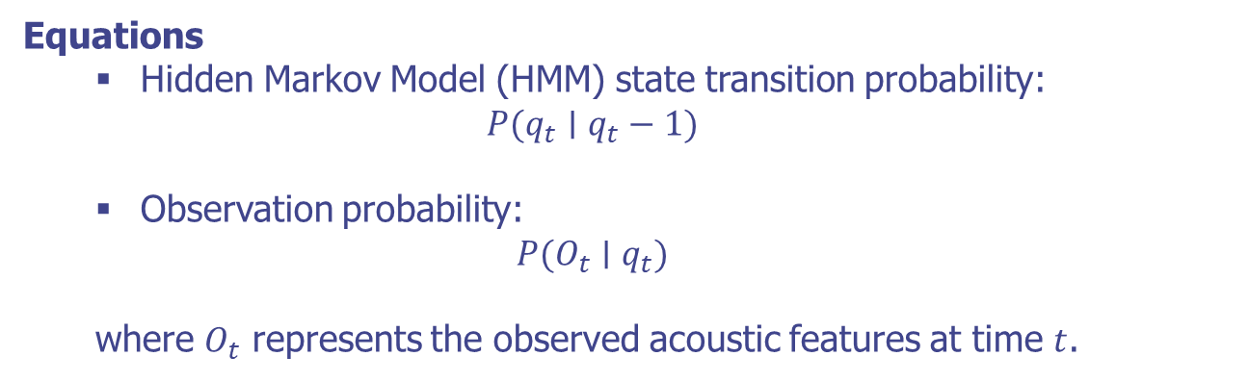
Basic ASR Formulation
Acoustic Modeling
Equations
Hidden Markov Model (HMM) state transition probability:
$$P(q_{t}∣q_{t}−1)$$
Observation probability:
$$P(O_{t}∣q_{t})$$
where $O_{t}$ represents the observed acoustic features at time $t$.

Slide 7
Basic ASR Formulation
Language Modeling
Formulation
Language modeling captures the statistical properties of spoken language.
N-gram models, recurrent neural networks (RNNs), and transformer models are commonly used.
Explanation
Language models estimate the probability of word sequences.
They incorporate syntactic and semantic constraints to improve recognition accuracy.

Slide 8
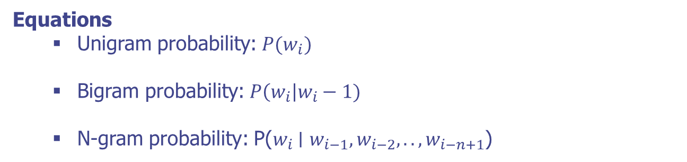
Basic ASR Formulation
Language Modeling
Equations
Unigram probability: $P(w_{i})$
Bigram probability: $P\left(w_{i}\right|w_{i}−1)$
N-gram probability: P($w_{i}$∣ $w_{i−1},w_{i−2},..,w_{i−n+1}$)

Slide 9
Basic ASR Formulation
Decoding
Formulation
Decoding involves finding the most likely word sequence given the acoustic and language models.
Common algorithms include Viterbi decoding and beam search.
Explanation
Decoding combines acoustic scores from the acoustic model and language scores from the language model.
The best hypothesis is selected based on the combined scores.

Slide 10
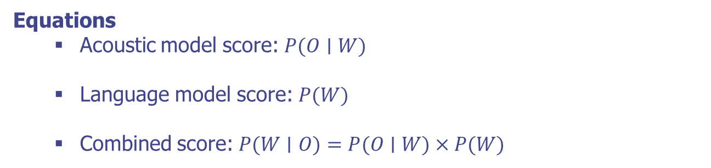
Basic ASR Formulation
Decoding
Equations
Acoustic model score: $P(O∣W)$
Language model score: $P(W)$
Combined score: $P(W∣O)=P(O∣W)×P(W)$

Slide 11
Basic ASR Formulation
Implementing a Basic ASR System
Objective: Develop a simple ASR system to recognize spoken digits.
Steps:
Collect audio data of spoken digits (0-9).
Extract MFCC features from the audio recordings.
Train a simple ASR model using the collected data.
Implement decoding to recognize spoken digits.
Input: Audio recording of spoken digits.
Output: Recognized digit sequence.

Slide 12
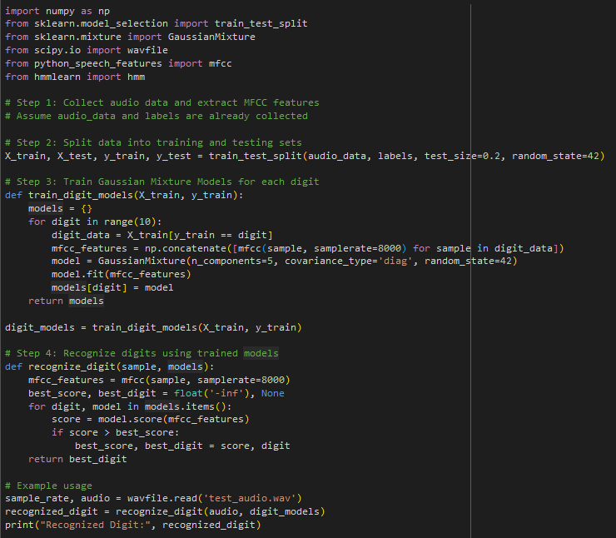
Basic ASR Formulation
Implementing a Basic ASR System

Slide 13
Basic ASR Formulation
Summary
Basic ASR formulation involves acoustic modeling, language modeling, and decoding components.
ASR systems play a crucial role in various NLU tasks, enabling machines to understand spoken language.

Slide 14
Overall Speech Recognition Process

Slide 15
Overall Speech Recognition Process
Introduction to Speech Recognition
Overview
Speech recognition is the process of converting spoken language into text.
It involves multiple stages: preprocessing, feature extraction, acoustic modeling, language modeling, and decoding.
Key points
Speech recognition enables various applications such as virtual assistants, transcription services, and more.
Integrating ASR with Natural Language Understanding (NLU) enhances user interaction with systems.

Slide 16

Overall Speech Recognition Process
Preprocessing
Overview
Preprocessing involves cleaning and preparing the audio signal for further analysis.
Key steps include noise reduction, normalization, and segmentation.
Explanation
Noise reduction: Remove background noise to enhance speech clarity.
Normalization: Adjust the audio signal to a standard level.
Segmentation: Divide the audio signal into manageable chunks.
Equations
Signal normalization: $x′(t)=\frac{x(t)}{max⁡(|x(t)|)}​$

Slide 17

Overall Speech Recognition Process
Feature Extraction
Overview
Extract relevant features from the audio signal that represent the speech content.
Common features include Mel-Frequency Cepstral Coefficients (MFCCs), Linear Predictive Coding (LPC), and spectrograms.
Explanation
MFCCs capture the short-term power spectrum of the sound.
LPC models the vocal tract.
Equations
MFCC calculation
$$MFCC=DCT(log⁡(Mel(FFT(x(t)))))$$

Slide 18
Overall Speech Recognition Process
Conclusion
Summary
The overall speech recognition process involves preprocessing, feature extraction, acoustic modeling, language modeling, and decoding.
Each stage plays a crucial role in converting spoken language into text accurately.
Future Directions
Continued advancements in deep learning and neural network architectures.
Integration with other NLU components for enhanced understanding and interaction.

Slide 19
User Interfaces (UI) and Multimodel UI

Slide 20
User Interfaces (UI) and Multimodel UI
Introduction
Overview
User Interfaces (UI) are the means through which users interact with systems and applications.
UIs in the context of ASR involve voice commands, visual feedback, and interactive elements.
Key Points
ASR-enabled UIs enhance user experience by allowing natural language interactions.
Effective UIs are intuitive, responsive, and provide clear feedback.

Slide 21
User Interfaces (UI) and Multimodel UI
Types of User Interfaces
Graphical User Interface (GUI): Traditional interface with visual elements like buttons, icons, and menus. GUIs are widely used in desktop and mobile applications.
Voice User Interface (VUI): Interface that allows users to interact using voice commands. VUIs are integral to voice assistants and smart devices.
Multimodal User Interface: This type of interface combines multiple modes of interaction, such as voice, touch, and gestures. It provides a more flexible and natural interaction experience.

Slide 22
User Interfaces (UI) and Multimodel UI
Multimodal User Interface
Overview
Multimodal UIs integrate multiple input methods, such as voice, touch, and gestures.
They use sensor fusion to combine data from different input modalities.
Key Points
Enhances accessibility and user experience by providing flexible interaction options.
Example: Using voice commands to control a device while providing touch-based feedback on a screen.

Slide 23
User Interfaces (UI) and Multimodel UI
Developing a Simple Voice User Interface (VUI)
Objective: Develop a simple VUI to control basic operations (e.g., turning on/off a virtual device).
Steps
Record voice commands for actions (e.g., "turn on", "turn off").
Implement ASR to convert speech to text.
Use simple NLU to interpret commands.
Perform actions based on recognized commands.
Input: Voice commands.
Output: Actions such as turning on/off a virtual device.

Slide 24
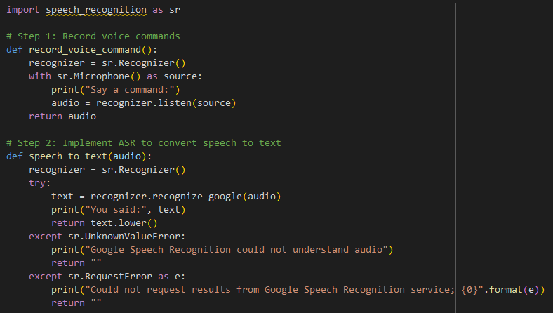
User Interfaces (UI) and Multimodel UI
Developing a Simple Voice User Interface (VUI)

Slide 25
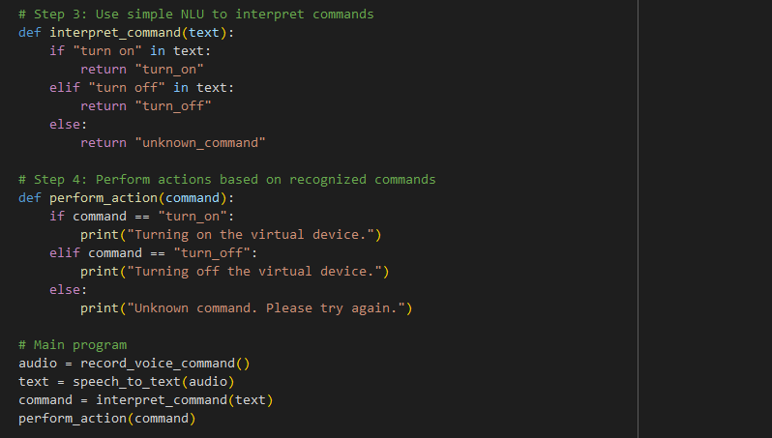
User Interfaces (UI) and Multimodel UI
Developing a Simple Voice User Interface (VUI)

Slide 26
User Interfaces (UI) and Multimodel UI
Summary
User Interfaces (UI) and Multimodal UIs are crucial for effective human-computer interaction.
VUIs leverage ASR and NLU to interpret and respond to voice commands.
Multimodal UIs combine various input methods for a flexible interaction experience.
Enhanced natural language processing for more accurate intent recognition.
Improved multimodal integration for seamless user experience.

Slide 27
Q & A

